Slide 1
UNIT - III
Database Design & Transaction Processing Concepts

Slide 2
Topics to be covered…
Database Design: Informal Design Guidelines for Relation Schemas; Functional Dependencies; Normal Forms Based on Primary Keys; General Definitions of Second and Third Normal Forms; Boyce-Codd Normal Form.
Transaction Processing Concepts: Introduction to Transaction processing, Transaction and System concepts, Desirable properties of Transactions and issues with concurrent transactions. 2PL and TSO algorithms.

Slide 3
First let us know ……
A relational schema is a blueprint used in database design to represent the data to be entered into the database and describe how that data is structured in tables (called relations in relational schemas)
Relational Database Design Process
Step 1: Define the Purpose of the Database (Requirement Analysis) ...
Step 2: Gather Data, Organize in tables and Specify the Primary Keys. ...
Step 3: Create Relationships among Tables. ...
Step 4: Refine & Normalize the Design.

Slide 4
Four Informal Guidelines for Relational Schema
Semantics of attributes
Reducing the redundant information in tuples
Reducing the NULL values in the tuple
Disallowing the possibility of generating spurious tuples.

Slide 5
Semantics of the Relation Attributes
Each tuple in a relation should represent one entity or relationship instance
  Only foreign keys should be used to refer to other entities
  Entity and relationship attributes should be kept apart as much as possible
  Design a schema that can be explained easily relation by relation. The semantics of attributes should be easy to interpret.

Slide 6
Example: (Confused)
Employee | E | SS | B | num
Department | N | Dno | Mgr
Dept_loc | Dno | Dloc
Project | name | no | P | Dn

Slide 7
Example: (Correct Picture)
pk
fk
Employee | Ename | SSN | Bdate | Dno
pk
Department | Dname | Dno | Mgrssn
fk
Dept_loc | Dno | Dloc
pk
fk
Project | Pname | Pno | Ploc | Dno
pk

Slide 8


Design a relation schema so that it is easy to explain its meaning. Do not combine attributes from multiple entity types and relationship types into a single relation. Intuitively, if a relation schema corresponds to one entity type or one relationship type, it is straightforward to interpret and to explain its meaning.

Slide 9
Redundant Information in Tuples and Update Anomalies
Mixing attributes of multiple entities may cause problems
  Information is stored redundantly wasting storage
  Problems with update anomalies:
    Insertion anomalies
    Deletion anomalies
    Modification anomalies

Slide 10
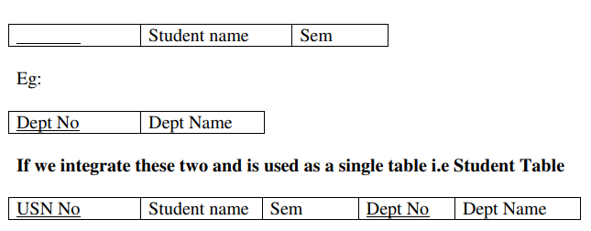
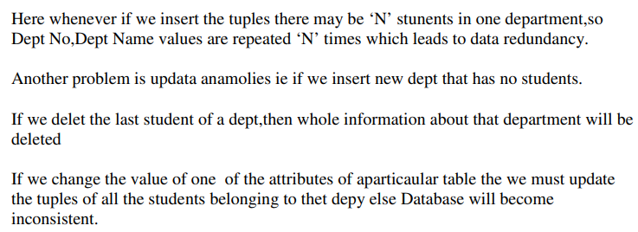
Example:1
USN_No

Slide 11
EXAMPLE OF AN UPDATE ANOMALY
Consider the relation:
EMP_PROJ ( Emp#, Proj#, Ename, Pname, No_hours)
  Update Anomaly
    Changing the name of project number P1 from “Billing” to “Customer-Accounting” may cause this update to be made for all 100 employees working on project P1
  Insert Anomaly
    Cannot insert a project unless an employee is assigned to .
    Inversely- Cannot insert an employee unless he/she is assigned to a project.
  Delete Anomaly
    When a project is deleted, it will result in deleting all the employees who work on that project. Alternately, if an employee is the sole employee on a project, deleting that employee would result in deleting the corresponding project.

Slide 12
EXAMPLE OF AN UPDATE ANOMALY (2)
Design a schema that does not suffer from
  insertion,
  deletion and
  update anomalies.
  If there are any present, then note them so that applications can be made to take them into account

Slide 13
Null Values in Tuples
Relations should be designed such that their tuples will have as few NULL values as possible
  Attributes that are NULL frequently could be placed in separate relations (with the primary key)
  Reasons for nulls:
  a. attribute not applicable or invalid
  b. attribute value unkown (may exist)
  c. value known to exist, but unavailable

Slide 14
Spurious Tuples
Bad designs for a relational database may result in erroneous results for certain JOIN operations
The "lossless join" property is used to guarantee meaningful results for join operations
The relations should be designed to satisfy the lossless join condition. No spurious tuples should be generated by doing a natural-join of any relations

Slide 15
Example
Employee Department
Join Employee Department
DNO | DNAME
1 | CS
2 | EC
SSN | ENAME | DNO
1 | Amit | 1
2 | Dilip | 2
SSN | ENAME | DNO | DNO | DNAME
1 | Amit | 1 | 1 | CS
1 | Amit | 1 | 2 | EC
2 | Dilip | 2 | 1 | CS
2 | Dilip | 2 | 2 | EC

Slide 16
Example
Employee Department
Join Employee Department
SSN | ENAME | DNO
1 | Amit | 1
2 | Dilip | 2
DNO | DNAME
1 | CS
2 | EC
SSN | ENAME | DNO | DNO | DNAME
1 | Amit | 1 | 1 | CS
1 | Amit | 1 | 2 | EC
2 | Dilip | 2 | 1 | CS
2 | Dilip | 2 | 2 | EC
Spurious Tuples

Slide 17
Guidelines
Guideline 1: Design a relation schema so that it is easy to explain its meaning
Guideline 2: Design the base relation schemas that has no insertion, deletion or modification anomalies.
Guideline 3: Avoid using NULL in relations
Guideline 4: join relations with equi-joins

Slide 18
Functional Dependencies
Definition: If one set of attributes in a table determines another set of attributes in the table, then the second set of attributes is said to be functionally dependent on the first set of attributes.
Example 1
ISBN
Title
Price
Table Scheme: {ISBN, Title, Price}
Functional Dependencies: {ISBN} → {Title}
{ISBN} → {Price}
0-321-32132-1
Balloon
$34.00
0-55-123456-9
Main Street
$22.95
0-123-45678-0
Ulysses
$34.00
1-22-233700-0
Visual Basic
$25.00
Notes:
Notes to Instructor: Need more rigor in the functional dependencies. With a few examples. May be create a class assignment for functional dependencies.

Slide 19
Functional Dependencies
Example 2
Table Scheme: {PubID, PubName, PubPhone}
Functional Dependencies: {PubId} → {PubPhone}
{PubId} → {PubName}
{PubName, PubPhone} → {PubID}
PubID
PubName
PubPhone
1
Big House
999-999-9999
2
Small House
123-456-7890
3
Alpha Press
111-111-1111
Example 3
AuID
AuName
AuPhone
Table Scheme: {AuID, AuName, AuPhone}
Functional Dependencies: {AuId} → {AuPhone}
{AuId} → {AuName}
{AuName, AuPhone} → {AuID}
1
Sleepy
321-321-1111
2
Snoopy
232-234-1234
3
Grumpy
665-235-6532
4
Jones
123-333-3333
5
Smith
654-223-3455
6
Joyce
666-666-6666
7
Roman
444-444-4444

Slide 20
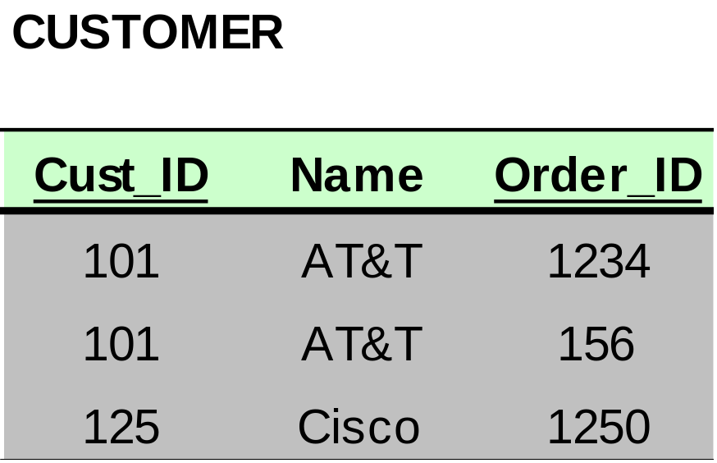
Dependencies: Definitions
Partial Dependency – when an non-key attribute is determined by a part, but not the whole, of a COMPOSITE primary key.
Partial Dependency

Slide 21
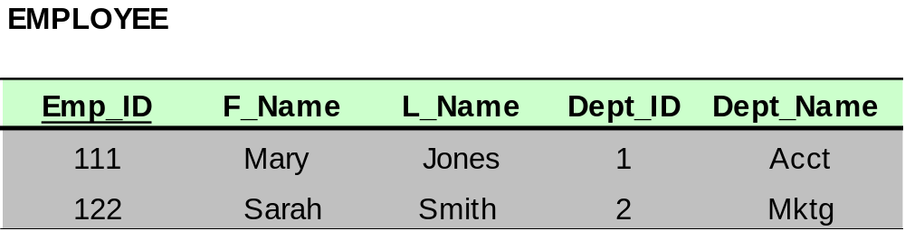
Dependencies: Definitions
Transitive Dependency – when a non-key attribute determines another non-key attribute.
Transitive Dependency

Slide 22
DATABASE NORMALIZATION

Slide 23
Introduction to Normalization
Normalization: Process of decomposing unsatisfactory "bad" relations by breaking up their attributes into smaller relations
Normal form: Condition using keys and FDs of a relation to certify whether a relation schema is in a particular normal form
  2NF, 3NF, BCNF based on keys and FDs of a relation schema
  4NF based on keys, multi-valued dependencies

Slide 24
Need for normalization
A properly normalized database should have the following characteristics
  Scalar values in each fields
  Absence of redundancy.
  Minimal use of null values.
  Minimal loss of information.

Slide 25
Levels of Normalization
Levels of normalization based on the amount of redundancy in the database.
Various levels of normalization are:
  First Normal Form (1NF)
  Second Normal Form (2NF)
  Third Normal Form (3NF)
  Boyce-Codd Normal Form (BCNF)
  Fourth Normal Form (4NF)
  Fifth Normal Form (5NF)
  Domain Key Normal Form (DKNF)
Redundancy
Number of Tables
Complexity
Most databases should be 3NF or BCNF in order to avoid the database anomalies.

Slide 26
Levels of Normalization
1NF
2NF
3NF
4NF
5NF
DKNF
Each higher level is a subset of the lower level

Slide 27
First Normal Form (1NF)
A table is considered to be in 1NF if all the fields contain
only scalar values (as opposed to list of values).
Example (Not 1NF)
ISBN
Title
AuName
AuPhone
PubName
PubPhone
Price
0-321-32132-1
Balloon
Sleepy, Snoopy, Grumpy
321-321-1111, 232-234-1234, 665-235-6532
Small House
714-000-0000
$34.00
0-55-123456-9
Main Street
Jones, Smith
123-333-3333, 654-223-3455
Small House
714-000-0000
$22.95
0-123-45678-0
Ulysses
Joyce
666-666-6666
Alpha Press
999-999-9999
$34.00
1-22-233700-0
Visual Basic
Roman
444-444-4444
Big House
123-456-7890
$25.00
Author and AuPhone columns are not scalar
Notes:
Having scalar values also means that all instances of a record type must contain the same number of fields.
A table not in first normal form is called un normalized

Slide 28
1NF - Decomposition
Place all items that appear in the repeating group in a new table
Designate a primary key for each new table produced.
Duplicate in the new table the primary key of the table from which the repeating group was extracted or vice versa.
Example (1NF)
ISBN
AuName
AuPhone
0-321-32132-1
Sleepy
321-321-1111
ISBN
Title
PubName
PubPhone
Price
0-321-32132-1
Snoopy
232-234-1234
0-321-32132-1
Balloon
Small House
714-000-0000
$34.00
0-321-32132-1
Grumpy
665-235-6532
0-55-123456-9
Main Street
Small House
714-000-0000
$22.95
0-55-123456-9
Jones
123-333-3333
0-123-45678-0
Ulysses
Alpha Press
999-999-9999
$34.00
0-55-123456-9
Smith
654-223-3455
1-22-233700-0
Visual Basic
Big House
123-456-7890
$25.00
0-123-45678-0
Joyce
666-666-6666
1-22-233700-0
Roman
444-444-4444
Notes:
1. The designated key will be the primary key of the original table concatenated with one or more data items from the new table.
For the first table the primary key is ISBN
For the second table the primary key is ISBN + Author Name

Slide 29
Is the following relation in 1NF?
USN | NAME | GENDER | CITY | HOBBIES
Notes:
Notes to Instructor: Need more rigor in the functional dependencies. With a few examples. May be create a class assignment for functional dependencies.

Slide 30
Is the following relation in 1NF?
USN | NAME | GENDER | CITY | HOBBIES
NO
Since hobbies will be multiple values !!!!!!!
Notes:
Notes to Instructor: Need more rigor in the functional dependencies. With a few examples. May be create a class assignment for functional dependencies.

Slide 31
Is the following relation in 1NF?
USN | NAME | GENDER | CITY | HOBBIES
NO
Since hobbies will be multiple values !!!!!!!
Can you convert it into 1NF???
Notes:
Notes to Instructor: Need more rigor in the functional dependencies. With a few examples. May be create a class assignment for functional dependencies.

Slide 32
Is the following relation in 1NF?
USN | NAME | GENDER | CITY | HOBBIES
NO
Since hobbies will be multiple values !!!!!!!
Can you convert it into 1NF???
YES
Notes:
Notes to Instructor: Need more rigor in the functional dependencies. With a few examples. May be create a class assignment for functional dependencies.

Slide 33
Is the following relation in 1NF?
USN | NAME | GENDER | CITY | HOBBIES
First way:
USN | NAME | GENDER | CITY
USN | HOBBIES
Notes:
Notes to Instructor: Need more rigor in the functional dependencies. With a few examples. May be create a class assignment for functional dependencies.

Slide 34
Is the following relation in 1NF?
USN | NAME | GENDER | CITY | HOBBIES
First way:
Second way:
USN | NAME | GENDER | CITY
USN | HOBBIES
USN | NAME | GENDER | CITY | HOBBIES
Notes:
Notes to Instructor: Need more rigor in the functional dependencies. With a few examples. May be create a class assignment for functional dependencies.

Slide 35
Is the following relation in 1NF?
USN | NAME | GENDER | CITY | HOBBIES
First way:
Second way:
Third way:
USN | NAME | GENDER | CITY
USN | HOBBIES
USN | NAME | GENDER | CITY | HOBBIES
USN | NAME | GENDER | CITY | Hobby1 | Hobby 2 | Hobby 3
Notes:
Notes to Instructor: Need more rigor in the functional dependencies. With a few examples. May be create a class assignment for functional dependencies.

Slide 36
Second Normal Form (2NF)
For a table to be in 2NF, there are two requirements
  The database is in first normal form
  All nonkey attributes in the table must be functionally dependent on the entire primary key
Note: Remember that we are dealing with non-key attributes

Slide 37
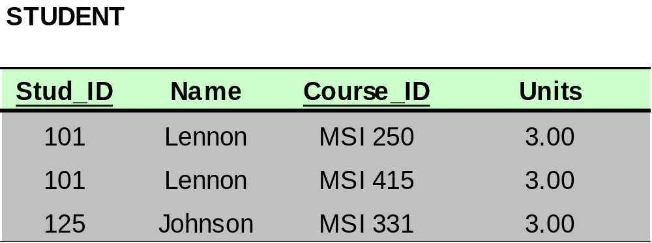
Bringing a Relation to 2NF
Composite Primary Key

Slide 38
Bringing a Relation to 2NF
Goal: Remove Partial Dependencies
Partial Dependencies
Composite Primary Key

Slide 39
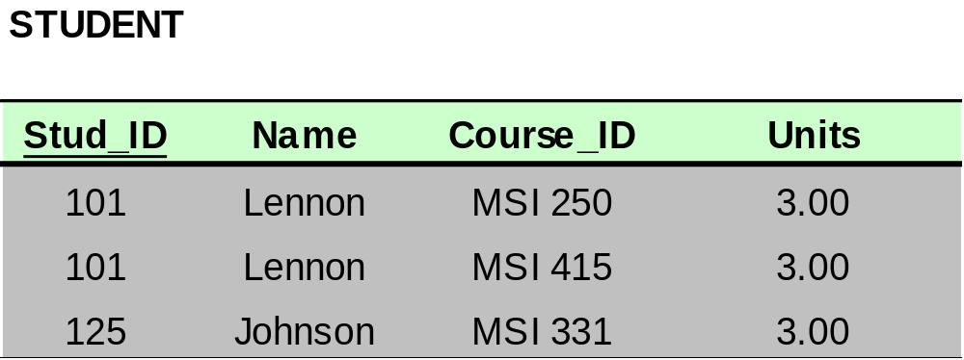
Bringing a Relation to 2NF
Remove attributes that are dependent from the part but not the whole of the primary key from the original relation. For each partial dependency, create a new relation, with the corresponding part of the primary key from the original as the primary key.

Slide 40
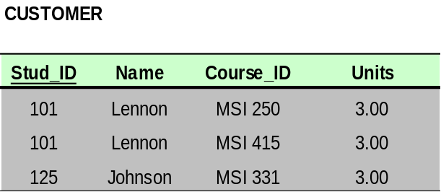

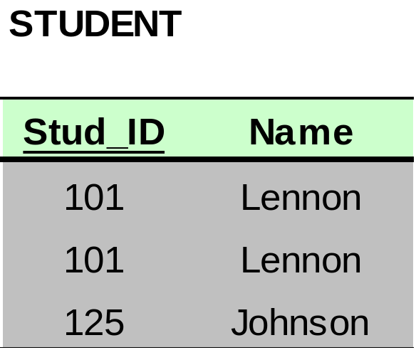
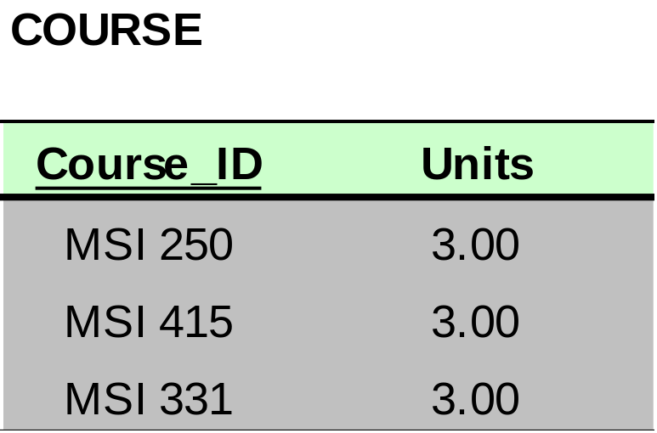
Bringing a Relation to 2NF

Slide 41
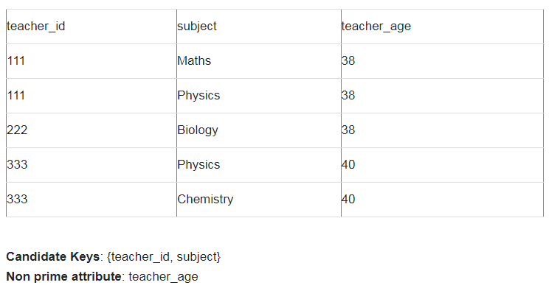

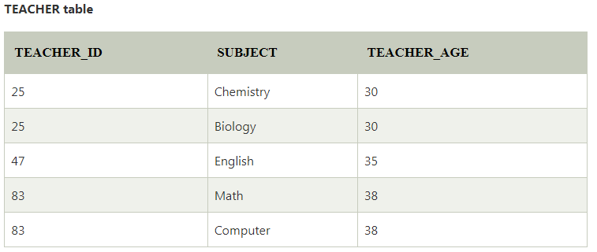
Example – Is the given relation in 2NF?
Non key attribute is dependent on a part of key, SO the relation is not in 2NF…..

Slide 42
Example – Is the given relation in 2NF?
Non key attribute is dependent on a part of key, SO the relation is not in 2NF…..

Slide 43
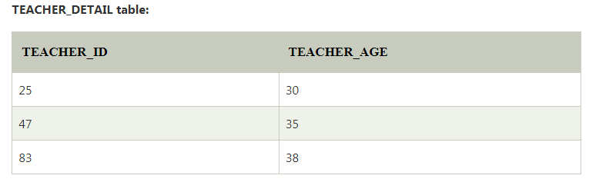
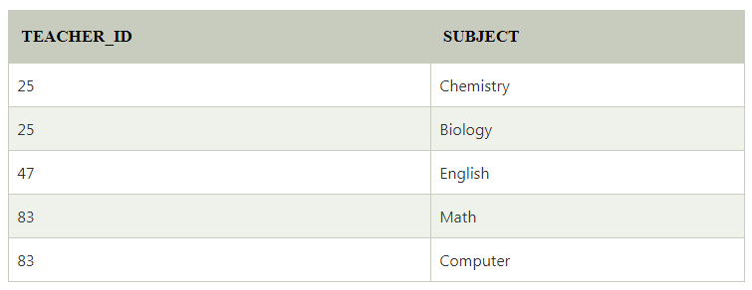
To convert the given table into 2NF, we decompose it into two tables:

Slide 44
Example 1 (Verify whether the relation in 2NF?)
Scheme → {Title, PubId, AuId, Price, AuAddress}
  Key → {Title, PubId, AuId}
  {Title, PubId, AuID} → {Price}
  {AuID} → {AuAddress}
Title
PubId
AuId
Price
AuAddress

Slide 45
Example 1 (Verify whether the relation in 2NF?)
Scheme → {Title, PubId, AuId, Price, AuAddress}
  Key → {Title, PubId, AuId}
  {Title, PubId, AuID} → {Price}
  {AuID} → {AuAddress}
Title
PubId
AuId
Price
AuAddress

Slide 46
Example 1 (Not 2NF)
Scheme → {Title, PubId, AuId, Price, AuAddress}
  Key → {Title, PubId, AuId}
  {Title, PubId, AuID} → {Price}
  {AuID} → {AuAddress}
  AuAddress does not belong to a key
  AuAddress functionally depends on AuId which is a subset of a key
Title
PubId
AuId
Price
AuAddress

Slide 47
Example 2 ((Verify whether the relation in 2NF?) )
Scheme → {City, Street, HouseNumber, HouseColor, CityPopulation}
  key → {City, Street, HouseNumber}
  {City, Street, HouseNumber} → {HouseColor}
  {City} → {CityPopulation}
City
Street
House_No
House_color
CityPopulation
Notes:
Let us consider the problems with the movie studio database:
Redundancy – City Population is repeated many times
Insertion anomaly – Whenever we add a new record we have to add unnecessary information. We can not add record until we know information about the city population
Deletion anomaly – Whenever we delete a record, useful information is deleted.
Update anomaly – The City Population needs to be updated in more than one location if it changes.

Slide 48
Example 2 ((Verify whether the relation in 2NF?) )
Scheme → {City, Street, HouseNumber, HouseColor, CityPopulation}
  key → {City, Street, HouseNumber}
  {City, Street, HouseNumber} → {HouseColor}
  {City} → {CityPopulation}
City
Street
House_No
House_color
CityPopulation
Notes:
Let us consider the problems with the movie studio database:
Redundancy – City Population is repeated many times
Insertion anomaly – Whenever we add a new record we have to add unnecessary information. We can not add record until we know information about the city population
Deletion anomaly – Whenever we delete a record, useful information is deleted.
Update anomaly – The City Population needs to be updated in more than one location if it changes.

Slide 49
Example 2 (Not 2NF)
Scheme → {City, Street, HouseNumber, HouseColor, CityPopulation}
  key → {City, Street, HouseNumber}
  {City, Street, HouseNumber} → {HouseColor}
  {City} → {CityPopulation}
  CityPopulation does not belong to any key.
  CityPopulation is functionally dependent on the City which is a proper subset of the key
City
Street
House_No
House_color
CityPopulation
Notes:
Let us consider the problems with the movie studio database:
Redundancy – City Population is repeated many times
Insertion anomaly – Whenever we add a new record we have to add unnecessary information. We can not add record until we know information about the city population
Deletion anomaly – Whenever we delete a record, useful information is deleted.
Update anomaly – The City Population needs to be updated in more than one location if it changes.

Slide 50
Example ((Verify whether the relation in 2NF?) )
Scheme → {RollNo, name, city, div, subcode, subjectname, fid, fname}
  key → {RollNo}
  {RollNo} → {name, city, div, subcode, subjectname, fid, fname}
RollNo
Name
City
div
subcode
subjectname
fid
Fname
Notes:
Let us consider the problems with the movie studio database:
Redundancy – City Population is repeated many times
Insertion anomaly – Whenever we add a new record we have to add unnecessary information. We can not add record until we know information about the city population
Deletion anomaly – Whenever we delete a record, useful information is deleted.
Update anomaly – The City Population needs to be updated in more than one location if it changes.

Slide 51
Example 3 ((Verify whether the relation in 2NF?) )
Scheme → {studio, movie, budget, studio_city}
  Key → {studio, movie}
  {studio, movie} → {budget}
  {studio} → {studio_city}
Studio
Movie
budget
Studio_city
Notes:
Let us consider the problems with the movie studio database:
Redundancy – City Population is repeated many times
Insertion anomaly – Whenever we add a new record we have to add unnecessary information. We can not add record until we know information about the city population
Deletion anomaly – Whenever we delete a record, useful information is deleted.
Update anomaly – The City Population needs to be updated in more than one location if it changes.

Slide 52
Example 3 ((Verify whether the relation in 2NF?) )
Scheme → {studio, movie, budget, studio_city}
  Key → {studio, movie}
  {studio, movie} → {budget}
  {studio} → {studio_city}
Studio
Movie
budget
Studio_city
Notes:
Let us consider the problems with the movie studio database:
Redundancy – City Population is repeated many times
Insertion anomaly – Whenever we add a new record we have to add unnecessary information. We can not add record until we know information about the city population
Deletion anomaly – Whenever we delete a record, useful information is deleted.
Update anomaly – The City Population needs to be updated in more than one location if it changes.

Slide 53
Example 3 (Not 2NF)
Scheme → {studio, movie, budget, studio_city}
  Key → {studio, movie}
  {studio, movie} → {budget}
  {studio} → {studio_city}
  studio_city is not a part of a key
  studio_city functionally depends on studio which is a proper subset of the key
Studio
Movie
budget
Studio_city
Notes:
Let us consider the problems with the movie studio database:
Redundancy – City Population is repeated many times
Insertion anomaly – Whenever we add a new record we have to add unnecessary information. We can not add record until we know information about the city population
Deletion anomaly – Whenever we delete a record, useful information is deleted.
Update anomaly – The City Population needs to be updated in more than one location if it changes.

Slide 54
2NF - Decomposition
If a data item is fully functionally dependent on only a part of the primary key, move that data item and that part of the primary key to a new table.
If other data items are functionally dependent on the same part of the key, place them in the new table also
Make the partial primary key copied from the original table the primary key for the new table. Place all items that appear in the repeating group in a new table
Example 1 (Convert to 2NF)
  Old Scheme → {Title, PubId, AuId, Price, AuAddress}
  New Scheme1→ {Title, PubId, AuId, Price}
  New Scheme2 → {AuId, AuAddress}
Title
PubId
AuId
Price
AuId
AuAddress
Notes:
If there is a table with columns A,B,C,D with Primary Key (A,B) & D is dependant on A (alone) then to be 2NF, you should reduce (split) tables as:
Table with columns A,D with Primary Key (A)
Table with columns A,B,C with Primary Key (A,B)

Slide 55
2NF - Decomposition
Example 2 (Convert to 2NF)
  Old Scheme → {Studio, Movie, Budget, StudioCity}
  New Scheme 1→ {Movie, Studio, Budget}
  New Scheme2 → {Studio, City}
Example 3 (Convert to 2NF)
  Old Scheme → {City, Street, HouseNumber, HouseColor, CityPopulation}
  New Scheme1 → {City, Street, HouseNumber, HouseColor}
  New Scheme2 → {City, CityPopulation}
Studio
Movie
budget
Studio
Studio_city
City
Street
House_No
House_color
City
CityPopulation

Slide 56
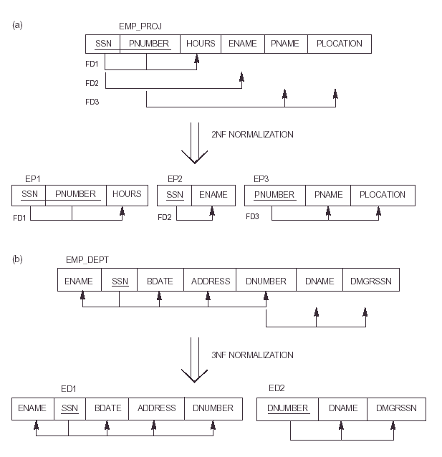
Can you convert the same into 2NF????

Slide 58
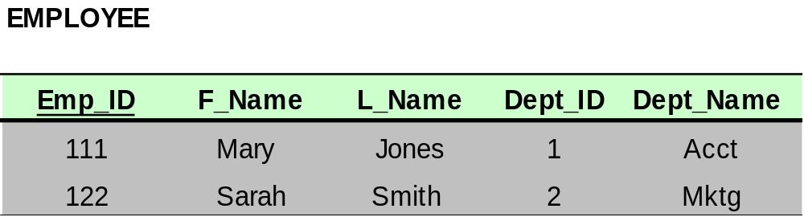
Bringing a Relation to 3NF
Goal: Get rid of transitive dependencies.
Transitive Dependency

Slide 59
Bringing a Relation to 3NF
Remove the attributes, which are dependent on a non-key attribute, from the original relation. For each transitive dependency, create a new relation with the non-key attribute which is a determinant in the transitive dependency as a primary key, and the dependent non-key attribute as a dependent.

Slide 60
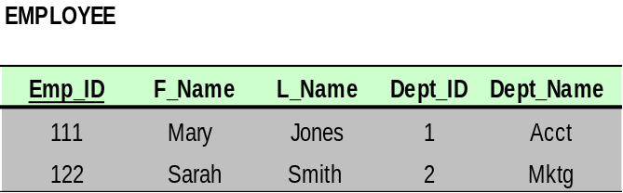
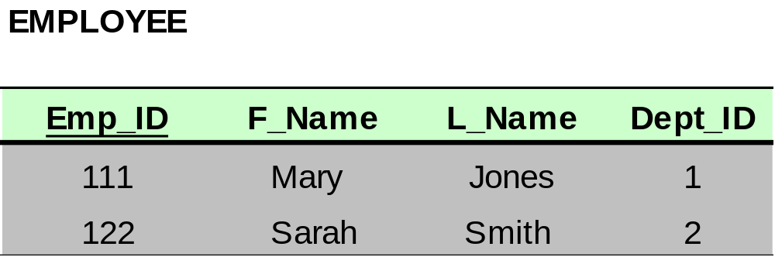
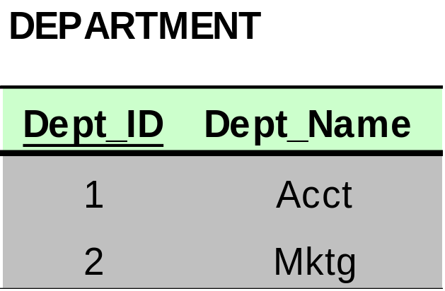
Bringing a Relation to 3NF

Slide 61
Third Normal Form (3NF)
This form dictates that all non-key attributes of a table must be functionally dependent on a candidate key i.e. there can be no interdependencies among non-key attributes.
For a table to be in 3NF, there are two requirements
  The table should be second normal form
  No attribute is transitively dependent on the primary key
Example ()
Scheme → {Title, PubID, PageCount, Price }
  Key → {Title, PubId}
  {Title, PubId} → {PageCount}
  {PageCount} → {Price}
Notes:
In the Book Schema Third Normal Form is violated since a non-key field is dependent on another non-key field and is transitively dependent on the primary key.

Slide 62
Third Normal Form (3NF)
This form dictates that all non-key attributes of a table must be functionally dependent on a candidate key i.e. there can be no interdependencies among non-key attributes.
For a table to be in 3NF, there are two requirements
  The table should be second normal form
  No attribute is transitively dependent on the primary key
Example (Not in 3NF)
Scheme → {Title, PubID, PageCount, Price }
  Key → {Title, PubId}
  {Title, PubId} → {PageCount}
  {PageCount} → {Price}
  Both Price and PageCount depend on a key hence 2NF
  Transitively {Title, PubID} → {Price} hence not in 3NF
Notes:
In the Book Schema Third Normal Form is violated since a non-key field is dependent on another non-key field and is transitively dependent on the primary key.

Slide 63
Third Normal Form (3NF)
Example 2 (Not in 3NF)
Scheme → {Studio, StudioCity, CityTemp}
  Primary Key → {Studio}
  {Studio} → {StudioCity}
  {StudioCity} → {CityTemp}
  {Studio} → {CityTemp}
  Both StudioCity and CityTemp depend on the entire key hence 2NF
  CityTemp transitively depends on Studio hence violates 3NF
Example 3 (Not in 3NF)
Scheme → {BuildingID, Contractor, Fee}
  Primary Key → {BuildingID}
  {BuildingID} → {Contractor}
  {Contractor} → {Fee}
  {BuildingID} → {Fee}
  Fee transitively depends on the BuildingID
  Both Contractor and Fee depend on the entire key hence 2NF
BuildingID
Contractor
Fee
100
Randolph
1200
150
Ingersoll
1100
200
Randolph
1200
250
Pitkin
1100
300
Randolph
1200
Notes:
Let us consider the problems with the movie studio database:
Redundancy – City Population is repeated many times
Insertion anomaly – Whenever we add a new record we have to add unnecessary information. We can not add record until we know information about the city population
Deletion anomaly – Whenever we delete a record, useful information is deleted.
Update anomaly – The City Population needs to be updated in more than one location if it changes.

Slide 64
3NF - Decomposition
Move all items involved in transitive dependencies to a new entity.
Identify a primary key for the new entity.
Place the primary key for the new entity as a foreign key on the original entity.
Example 1 (Convert to 3NF)
  Old Scheme → {Title, PubID, PageCount, Price }
  New Scheme → {PubID, PageCount, Price}
  New Scheme → {Title, PubID, PageCount}
Notes:
If there is a table with columns A,B,C with Primary Key (A) and C is dependant on B (B → C) then to be 3NF, the tables become
Table with columns B,C with Primary Key (B)
Table with fields A,B with Primary Key ( A), and Foreign Key (B)

Slide 65
3NF - Decomposition
Example 2 (Convert to 3NF)
  Old Scheme → {Studio, StudioCity, CityTemp}
  New Scheme → {Studio, StudioCity}
  New Scheme → {StudioCity, CityTemp}
Example 3 (Convert to 3NF)
  Old Scheme → {BuildingID, Contractor, Fee}
  New Scheme → {BuildingID, Contractor}
  New Scheme → {Contractor, Fee}
BuildingID
Contractor
Contractor
Fee
100
Randolph
Randolph
1200
150
Ingersoll
Ingersoll
1100
200
Randolph
Pitkin
1100
250
Pitkin
300
Randolph

Slide 66
Can you convert the same into 3NF????

Slide 68


Slide 69
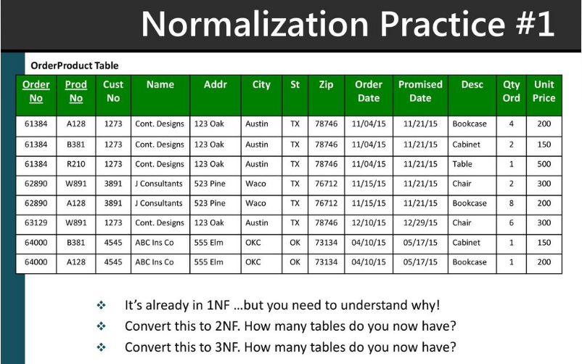

Slide 70


Slide 71
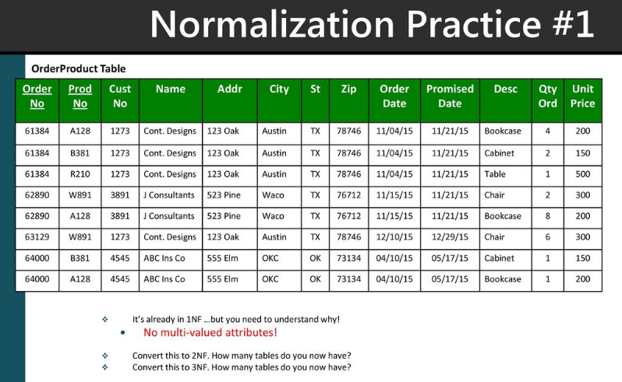

Slide 72
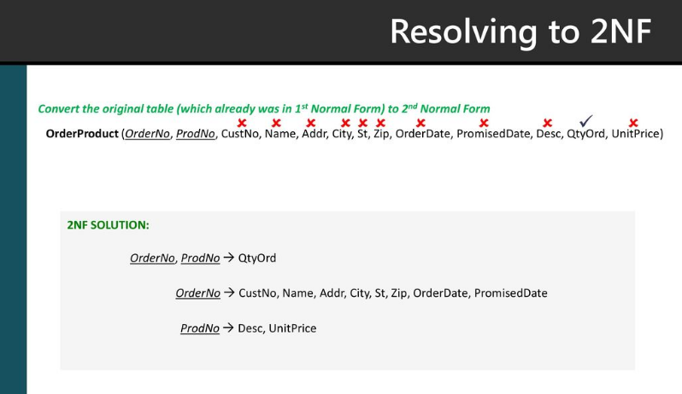

Slide 73
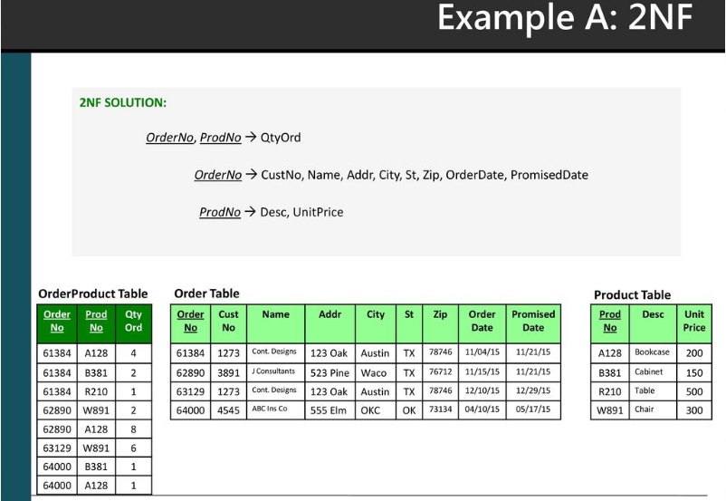

Slide 74
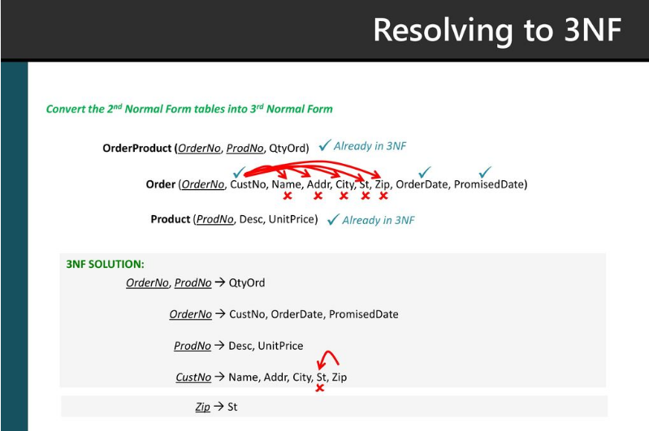

Slide 75
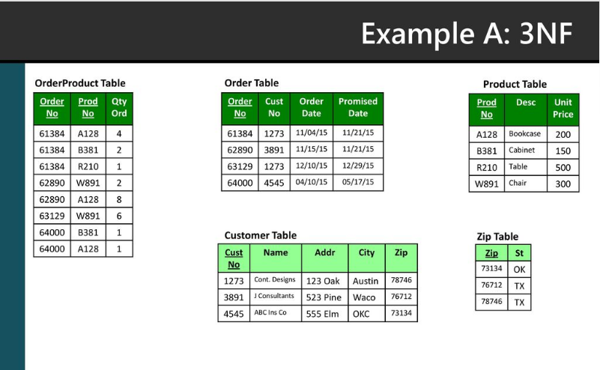

Slide 76


Slide 77
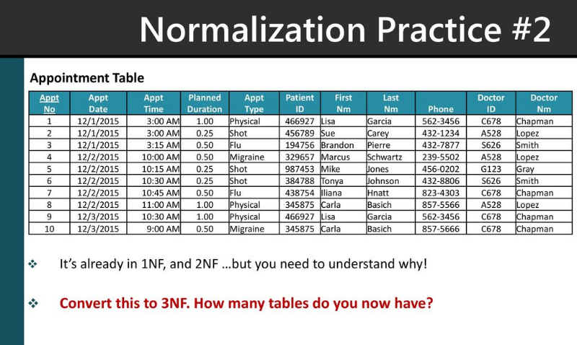

Slide 78


Slide 79
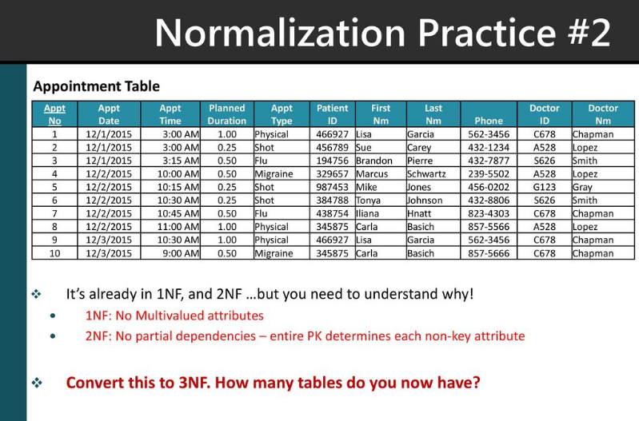

Slide 80
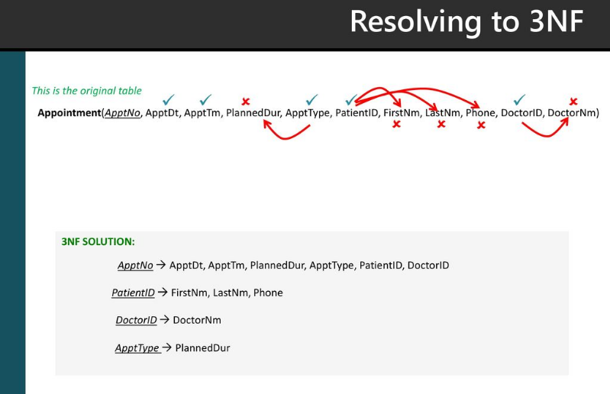

Slide 81
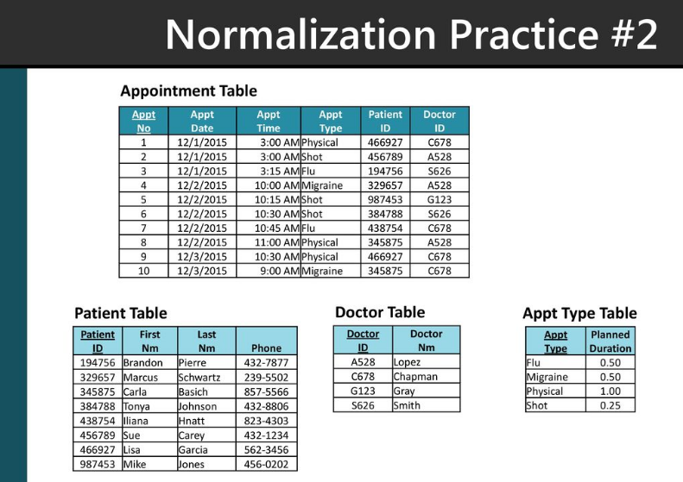

Slide 82
Boyce-Codd Normal Form (BCNF)
BCNF does not allow dependencies between attributes that belong to candidate keys.
BCNF is a refinement of the third normal form in which it drops the restriction of a non-key attribute from the 3rd normal form.
Third normal form and BCNF are not same if the following conditions are true:
  The table has two or more candidate keys
  At least two of the candidate keys are composed of more than one attribute
  The keys are not disjoint i.e. The composite candidate keys share some attributes
Example 1 - Address (Not in BCNF)
Scheme → {City, Street, ZipCode }
  Key1 → {City, Street }
  Key2 → {ZipCode, Street}
  No non-key attribute hence 3NF
  {City, Street} → {ZipCode}
  {ZipCode} → {City}
  Dependency between attributes belonging to a key
Notes:
The second and third normal forms assume that all attributes not part of the candidate keys depend on the candidate keys but does not deal with dependencies within the keys. BCNF deals with such dependencies.
Under third normal form all non-key columns must be functionally dependent on a candidate key. Under BCNF, even columns that are part of a candidate key must be dependent on another candidate key, if they have a dependency at all.
For most tables third normal form and BCNF are the same. Third normal form does not cover some specific cases for which BCNF was created. Third normal form and BCNF are not same if the following conditions are true:
The table has two or more candidate keys
At least two of the candidate keys are composed of more than one attribute
The keys are not disjoint i.e. The composite candidate keys share some attributes

Slide 83
Boyce Codd Normal Form (BCNF)
Example 2 - Movie (Not in BCNF)
Scheme → {MovieTitle, MovieID, PersonName, Role, Payment }
  Key1 → {MovieTitle, PersonName}
  Key2 → {MovieID, PersonName}
  Both role and payment functionally depend on both candidate keys thus 3NF
  {MovieID} → {MovieTitle}
  Dependency between MovieID & MovieTitle Violates BCNF
Example 3 - Consulting (Not in BCNF)
Scheme → {Client, Problem, Consultant}
  Key1 → {Client, Problem}
  Key2 → {Client, Consultant}
  No non-key attribute hence 3NF
  {Client, Problem} → {Consultant}
  {Client, Consultant} → {Problem}
  Dependency between attributess belonging to keys violates BCNF
Notes:
A management consulting firm has several clients and consultants. A client can have several problems and the same problem can be an issue for several clients. Each consultant specializes in only one problem type (e. g marketing, production) but several consultants could advise on one problem. For each problem, the client is advised by only one consultant.

Slide 84
BCNF - Decomposition
Place the two candidate primary keys in separate entities
Place each of the remaining data items in one of the resulting entities according to its dependency on the primary key.
Example 1 (Convert to BCNF)
  Old Scheme → {City, Street, ZipCode }
  New Scheme1 → {ZipCode, Street}
  New Scheme2 → {City, Street}
Loss of relation {ZipCode} → {City}
  Alternate New Scheme1 → {ZipCode, Street }
  Alternate New Scheme2 → {ZipCode, City}
Notes:
If there is a table with columns A,B,C with Primary Key (A) and C is dependant on B (B → C) then to be 3NF, the tables become
Table with columns B,C with Primary Key (B)
Table with fields A,B with Primary Key ( A), and Foreign Key (B)

Slide 85
Decomposition – Loss of Information
If decomposition does not cause any loss of information it is called a lossless decomposition.
If a decomposition does not cause any dependencies to be lost it is called a dependency-preserving decomposition.
Any table scheme can be decomposed in a lossless way into a collection of smaller schemas that are in BCNF form. However the dependency preservation is not guaranteed.
Any table can be decomposed in a lossless way into 3rd normal form that also preserves the dependencies.
  3NF may be better than BCNF in some cases
Use your own judgment when decomposing schemas

Slide 86
BCNF - Decomposition
Example 2 (Convert to BCNF)
  Old Scheme → {MovieTitle, MovieID, PersonName, Role, Payment }
  New Scheme → {MovieID, PersonName, Role, Payment}
  New Scheme → {MovieTitle, PersonName}
Loss of relation {MovieID} → {MovieTitle}
  New Scheme → {MovieID, PersonName, Role, Payment}
  New Scheme → {MovieID, MovieTitle}
We got the {MovieID} → {MovieTitle} relationship back
Example 3 (Convert to BCNF)
  Old Scheme → {Client, Problem, Consultant}
  New Scheme → {Client, Consultant}
  New Scheme → {Client, Problem}

Slide 87
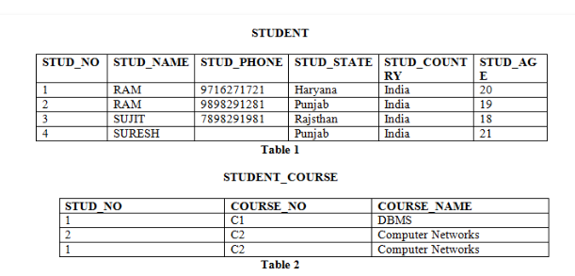
Candidate Key: The minimal set of attribute which can uniquely identify a tuple is known as candidate key.
  For Example, STUD_NO in STUDENT relation.
Super Key: The set of attributes which can uniquely identify a tuple is known as Super Key.
  For Example, STUD_NO, (STUD_NO, STUD_NAME) etc.

Slide 88
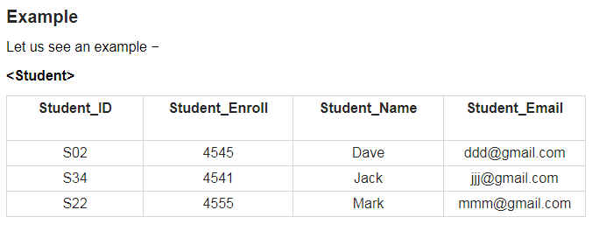
Super key(Examples)
The following are the super keys for the above table −
{Student_ID}
{Student_Enroll}
{Student_Email}
{Student_ID, Student_Enroll}
{Studet_ID, Student_Name}
{Student_ID, Student_Email}
{Student_Name, Student_Enroll}
{Student_ID, Student_Enroll, Student_Name}
{Student_ID, Student_Enroll, Student_Email}
{Student_ID, Student_Enroll, Student_Name, Student_Email}
The following would be the candidate key from the above −
{Student_ID}
{Student_Enroll}
{Student_Email}

